Slide 1
TELCO CUSTOMER CHURN ANALYTICAL REPORT
UNDERSTANDING WHY CUSTOMERS ARE LEAVING
PREPARED BY
ONWUSA, CHUKWUDI
TOOLS USED
POWER BI | POWER QUERY | DAX | EXCEL | Data Modeling

Slide 2
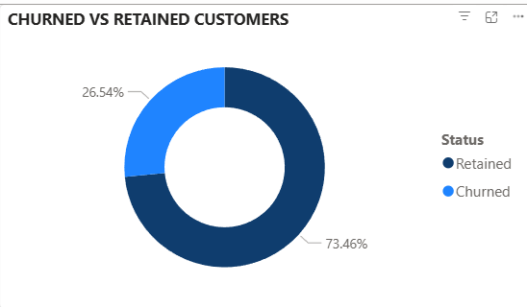
PROBLEM STATEMENT
•
The business is losing more than one in four customers, which can reduce revenue and weaken long-term growth.
•
The main goal is to understand the common features of customers who leave the business.
•
The analysis focuses on factors such as customer tenure, contract type, services, payment methods and others.
Why are customers leaving the company, and which factors contribute most to customer churn?

Slide 3
DATASET OVERVIEW
The dataset consists of 7,043 unique customers record and 21 attributes
The data includes attributes such as customer demography, account information, services used, and churn status.
The churn status shows whether each customer stayed with the company or left.
The dashboard was built to compare churn across these attributes to identify attrition caused, and predict behavior to retain customers.

Slide 4
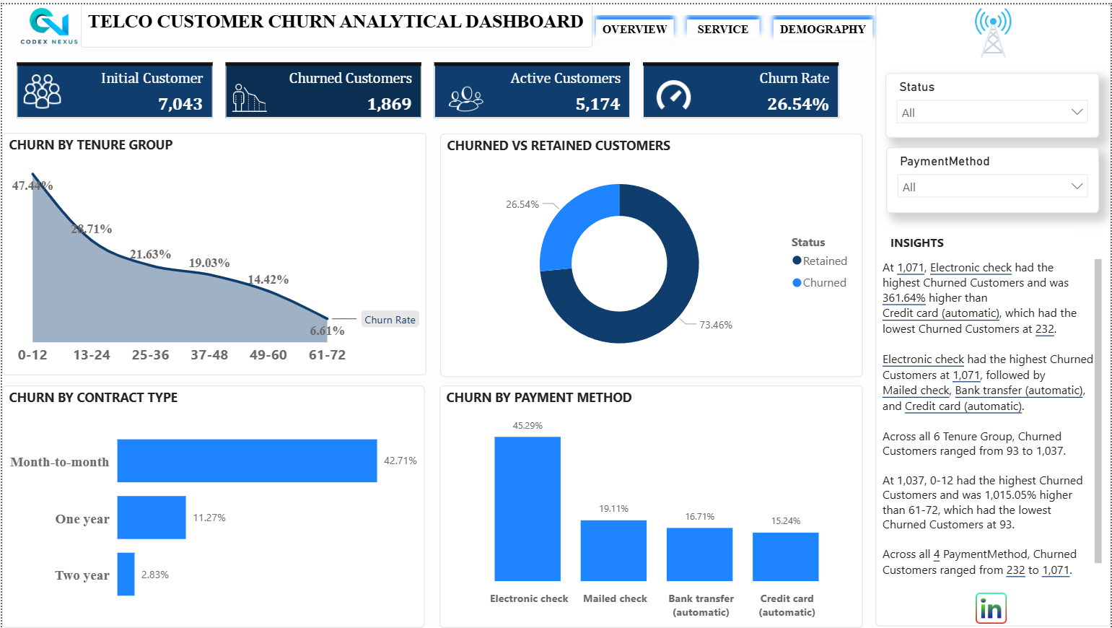
KEY FINDINGS – OVERVIEW
Overall churn rate is 26.54% that is 5,174 active customers compared to initial 7,043. Which also means that more than 1 out of every customer signed up customer churns.
New customers in the first 12 months who signed a contract of <= 1 year leave most often.
Electronic check users are at high-risk to churn easily.

Slide 5
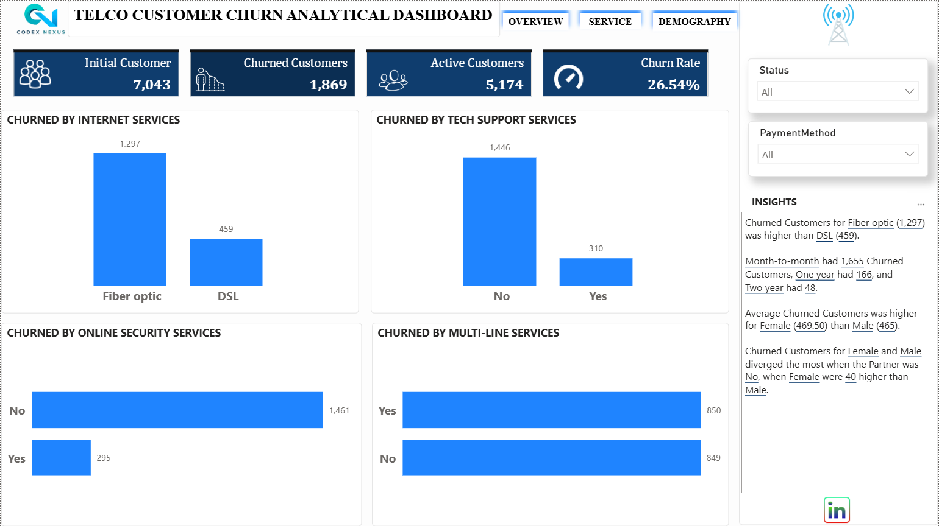
KEY FINDINGS – SERVICES
Customers without tech support make up the largest share of churned customers.
Fiber optic customers have the highest churn among internet service groups.
Customers without Online security services has a higher churn rate (1,461 to 295)

Slide 6
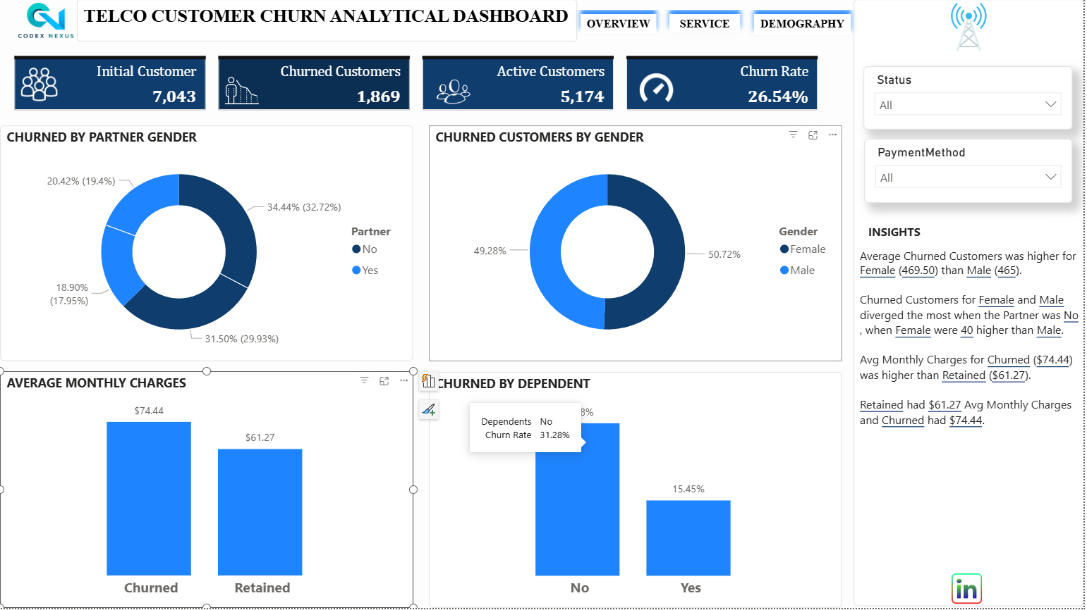
KEY FINDINGS – DEMOGRAPHY
Average monthly charge for churn was $74.44 was higher than retained $61.27.
Customers who has no dependent(s) churn higher 31.28% compared to those with dependent(s) 15.45%
Female customers churn at a higher rate of 50.72% than male customers 49.38%.
Unmarried customers churn at a higher rate

Slide 7
Recommendations
Encourage Long-Term Contracts
Improve Customer Value
Promote Support Services
Focus on New Customers
Develop Targeted Retention Campaigns

Slide 8
Conclusion
Insight - Customer churn is affected by contract type, monthly charges, service usage, and customer demographics.
.
Business Action - Build retention campaigns around contract upgrades, first-year support, pricing reviews, and better service help.
Expected Result - Targeted action can reduce avoidable customer loss and protect recurring revenue.

